Slide 1
Inventory Management System
MIS 631 C
Team - 1: Ankith Prakash Chikkur, Bhavana Jayaram, Hao Wang, Jusak Praveen Sikharam, Prameela Rani Vakkala Gadda, Rafiuddin Mohammed

Slide 2
INTRODUCTION
An inventory management system is the combination of technology (hardware and software) and processes and procedures that oversee the monitoring and maintenance of stocked products.
It can widely be used by normal shops, departmental stores or MNCs for keeping a proper track of the stock.
With the help of this system, we can fix a minimum quantity of any inventory below which we need to place an order for that inventory.

Slide 3
BUSINESS PROBLEMS
The delay of the Inventory items in Walmart. For Example: Diary Products, Bread& bakery, grocery, beauty and personal care, household essentials, kitchen & dining, Electronics, Organic Things.
Help us in maintain the exact count of any product.
Can help us to set minimum quantity of any product below which we can order the product from manufacturer.

Slide 4

DATA AND SCOPE
Collected the data based on inventory (Delay of products in Walmart).
Using ER Diagrams and SQL

Slide 5
GOALS OF PROPOSED SYSTEM
Planned approach towards working: This will help in retrieval of information as well as its storage.
Accuracy: The level of accuracy in the proposed system will be higher.
Reliability: The reliability of the proposed system will be high.
No Redundancy: No information is repeated anywhere, in storage or otherwise.
Immediate retrieval of information
Immediate storage of information
Easy to Operate

Slide 6
ENTITY SETS & ATTRIBUTE
10 table:
Brands {bid, brandname}
inv_user {user_id, name, password, last_login, user_type}
Categories {cid, category_name}
Products {pid, pname, p_stock, price, added_date, bid, cid, sid}
Stores {sid, sname, address, mobno}
Providers {bid, sid, discount}
Customer_cart {cust_id, name, mobno}
Select_product {pid, cust_id, quantity}
Transaction {id, cust_id, total_amount, paid, due, gst, discount, payment_method}
Invoice {item_no, product_name, quantity, net_price, id}

Slide 7
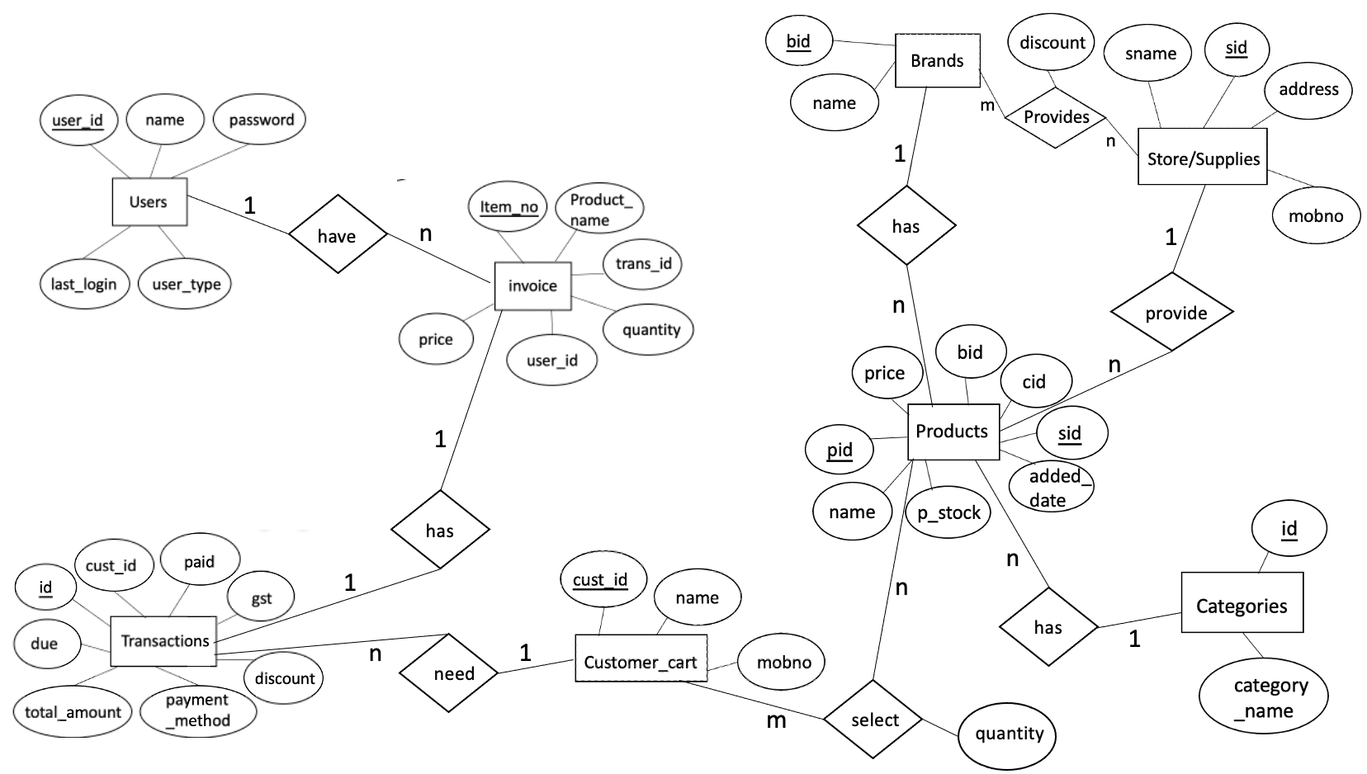
ER DIAGRAM

Slide 8
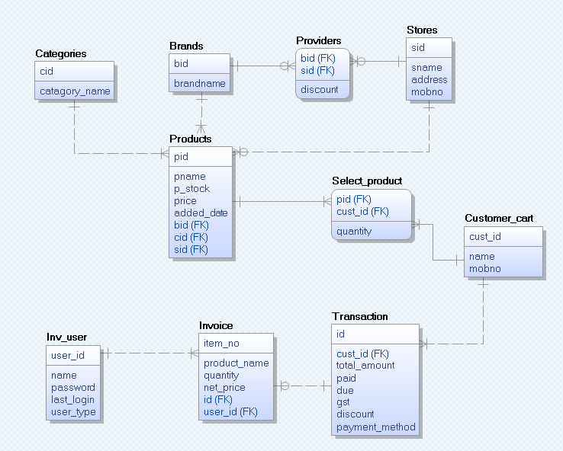
LOGICAL DIMENSION MODEL
Star Schema of Inventory

Slide 9
ACHIEVEMENT
Forecast the sales by analyzing the previous sales statistics.
Get an idea that when we need to order new inventory.
Reduce the chances of any kind of frauds done by the staff members in the inventory.
Customer details can be added.
Invoice generation.
Keep a track of transactions received through different payment methods.

Slide 10
THANK YOU!

